Slide 1
iPad Basics
Steve Kruse
2014 Summer Tech Training

Slide 2
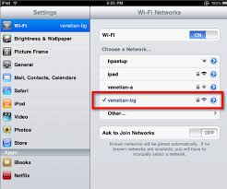
Settings
Wi-Fi
ORIOLENET
Should automatically connect
ORIOLESTUDENT/orioleguest
Not functional for iPad
Change Wi-Fi
Settings -> Wi-Fi -> Click on ORIOLENET
No internet? How do I troubleshoot?

Slide 3
Settings
General
About
Breakdown of your iPad
Songs, apps, photos, etc
Accessibility
Guided Access
Set the iPad to a specific app and user needs passcode to get out of it
Usage
Total Storage Capacity, Available Storage Capacity, and how much space do apps take?
Auto-Lock

Slide 4
Settings
iTunes and App Store
Add your school iTunes account to speed up app downloads.
Automatic Downloads
Automatically download new purchases made on other devices

Slide 5
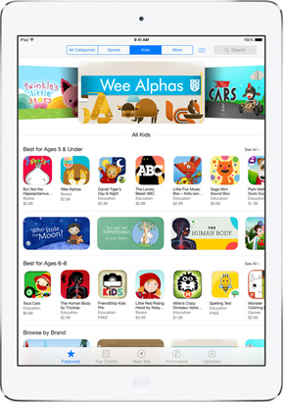
Searching Apps
Many ways to search for apps
App Store on the iPad
iTunes Store on your computer
Using a search engine like Google
Example Search Terms:
2014 Top Education Apps iPad
Best Free educational ipad Apps
Note: Some sites aren’t updated so may include apps that are listed as free but have since turned to paid apps. They may also list apps that are no longer available for download.

Slide 6
Downloading Free Apps
Use your school iTunes account to download free apps on your iPad.
Need to pay? Contact your supervisor and myself to initiate the process.
Click on App Store
On the top right of the App Store, click in the search bar and type what you are looking for: (Examples include: Elementary math, spelling games, etc)
Click on the “Free” button next to your app, then click install. You will most likely need to enter your password.
To get more info on apps, click on the app before downloading, click on the app title or search for it in your browser.

Slide 7
Updating your Free Apps
New updates for your apps come out regularly.
Updates are usually put out in order to fix bugs that are causing problems or enhancing the game based on user suggestions.
Click on the App Store
On the bottom right of the app store, click on “Updates.”
Click on “Update” and type in your password to begin updating.
Note: If your iTunes account doesn’t show when you click update, the app was installed by me. If you want it updated, I have to do it. If you want me to, just contact me and we will setup a time to do so. It usually takes a day or so.

Slide 8
Managing Apps
Creating Folders
Click and hold on an app until it starts to shake. Drag your app on top of another app and a new folder will be created.
Rename the Folder, if needed
Hit the “Home” Button to make the apps quit “shaking”
Moving Apps
Click and hold on an app until it starts to shake, then drag the app wherever you want it to go.
To move to a different page, hold the app towards the side of the page until it flips to the other page.

Slide 9
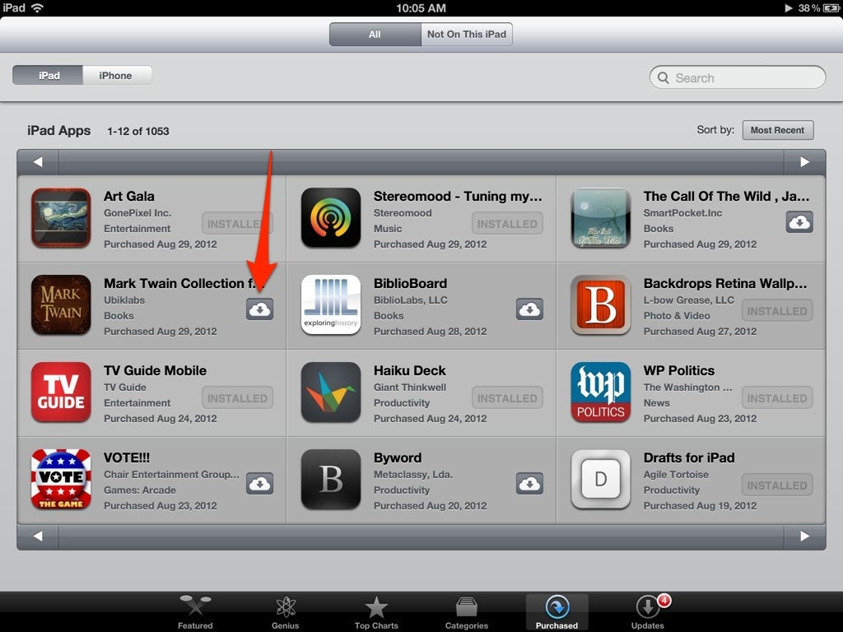
Managing Apps
Removing Apps
Click and hold on an app until it starts to shake.
Click on the X and then hit “Delete” to confirm.
Re-adding Apps
Go to the App Store
At the bottom of the App Store, click on “Purchased.”
At the top of the App Store, click on “Not on this iPad.”
Click on the cloud with an arrow on it. Confirm with your password.

Slide 10
Reflector App
2014 Summer Tech Workshop

Slide 11
What is Reflector?
Reflector is an AirPlay receiver that allows you to wirelessly display your iPad or iPhone on a number of devices.
Trial Version: Free for 7 days.
Full Version: $10.39(Try the Trial then talk to your principal)

Slide 12
How to connect
On PC, turn on Reflector
Double-click the Reflector shortcut on your desktop
Start->Programs->Reflector->Reflector
For now, we will use the Trial Version, good for 7 days.

Slide 13
Connect the iPad
On the iPad, swipe up from the bottom of the screen.
Find and click on AirPlay.
Depending on the type of iPad, you may need to swipe right/left to find it
Find and click on the Computer that you wish to connect to.
Under the computer name, toggle the Mirroring switch to On
Your iPad screen should show up on your computer

Slide 14
Disconnect the iPad
On the iPad, swipe up from the bottom of the screen.
Find and click on AirPlay.
Depending on the type of iPad, you may need to swipe right/left to find it
Find and click on the Computer that you wish to connect to.
Under the computer name, toggle the Mirroring switch to Off
Your iPad screen should now disappear from your computer screen

Slide 15
Reflector Settings
To change some of the Reflector Settings, turn on Reflector:
Double-click the Reflector shortcut on your desktop
Start->Programs->Reflector->Reflector
In the Windows Notification Area, double-click on the Reflector icon.
Password Protection
Launch full-screen

Slide 16
Transfer Videos from ipad to PC
2014 Summer Tech Workshop

Slide 17
Wi-Fi Photo Transfer
A Free program that allows you to wirelessly connect your iPad to your Computer and download any and all pictures/videos.

Slide 18
Procedure
Open Wi-Fi Photo Transfer on your iPad.
On your computer, open a web browser(Internet Explorer seems to work best).
In your web browser, type the URL address listed in Wi-Fi Photo Transfer(Exactly as you see it)
If you get an “Access Denied” Error, follow the instructions shown to fix it and try again.

Slide 19
More Procedures
Once you see your photos, click on “Camera Roll.”
Click on the “download in .zip” button.
Place a checkmark in all of the pictures you would like to download(or select a range).
Once selected, click on the “download selected” button.

Slide 20
Even More…
Once your download has finished, click on the images.zip file to open it.
Your pictures are in this folder but they are not usable until we move them out of it. Select the pictures and move them to a different location(Desktop, for instance)
You have now transferred your photos from your iPad to your computer!

Slide 21
A few notes….
In order to keep the download progressing, make sure the Wi-Fi Photo Transfer app stays open and the iPad stays lit up. This can be tricky when you start moving large video files from the iPad to the Computer.
This can work in any setting(home, for instance) as long as the computer and the iPad are on the same network. If they are on different networks, they will not be able to communicate with each other.
Don’t forget to move the files out of the original folder to get them to work.
The address you type in to your web browser will not always be the same. It could change from time to time.

Slide 22
Movie Maker
Create and Edit Videos
Part of the Windows Essentials Package

Slide 23
Some things to consider…
When you add video, picture, and audios into Movie Maker, Movie Maker only points to the location. If those files are moved or deleted, those files will no longer work with Movie Maker.
Recommendation: Put all files needed for a project in one folder and import them from there.
If you need to move the folder of files, you can easily repoint Movie Maker to the correct spot again.

Slide 24
Movie Maker
How to:
Insert Pictures and Videos
Rotate if needed
Edit Videos
Trim Video
Split Video
Change Sound
Animations/Visual Effects

Slide 25
Add Music
Music/Narration
Trim Audio
Start Audio at different point
Duration
Move Audio
Change Volume

Slide 26
Movie Maker
Other things
Titles
Credits

Slide 27
Saving your Movie Maker Project
File - > Save Project As
Name your project
This file can always be edited again
Recommendation – Always save your project file before making your actual video

Slide 28
Creating a movie from your Project
File -> Save Movie as ->
Next step depends on what you are trying to do with the video
For High-Definition Display
For Computer
For email

Slide 29
Windows DVD Maker
Windows DVD Maker is a feature that you can use to make DVDs that you can watch on a computer or on a TV using a regular DVD player.
Start -> Programs -> Windows DVD Maker

Slide 30
Create a DVD
Choose photos and videos to add
Add items
Can be videos and/or pictures
DVD Title
Default set at today’s date.

Slide 31
Options
Menu Options
Start with menu
End with Menu
Play in a continuous loop
Aspect
4:3
16:9
Burn Speed
Fastest(if you run into errors, use a slower speed)

Slide 32
Menu Preview
Menu Text
Edit/Remove menus
Change Fonts
Customize Menu
Randomly select parts of video
Change if you want to
Pictures can be used for menu too

Slide 33
Menu Customization
Scene Button Styles
Change shape and size of button
When finished, click the “Burn” Button

